Slide 1

Department of Computer Science and Engineering
IIT Delhi
COP290 ASSIGNMENT 2
Umang Tripathi -2022CS51134
Parth Verma - 2022CS11936

Slide 2


Introduction
Overview:
Our project aims to gamify the crucial social cause of protecting nature, leveraging interactive and engaging gameplay to raise awareness about proper waste disposal and environmental conservation. By merging entertainment with education, we endeavor to inspire action and promote sustainable practices among players of all ages.
Rationale Behind Gamiﬁcation:
Gamiﬁcation offers a powerful platform for transforming mundane tasks into engaging experiences. By infusing elements of play, competition, and reward into educational content, we aim to captivate audiences and motivate them to take positive actions towards protecting the environment.

Slide 3

How To Play!
Install our code from GitHub , Install all the appropriate libraries .
cd game4
Run "node index.js" in terminal Open a New Terminal
cd Website
Run "python3 app.py"
Go to your settings to ﬁnd your IP address, enter into the input prompt .
Go to the Link on terminal, This should take user to the Login Page.

Slide 4

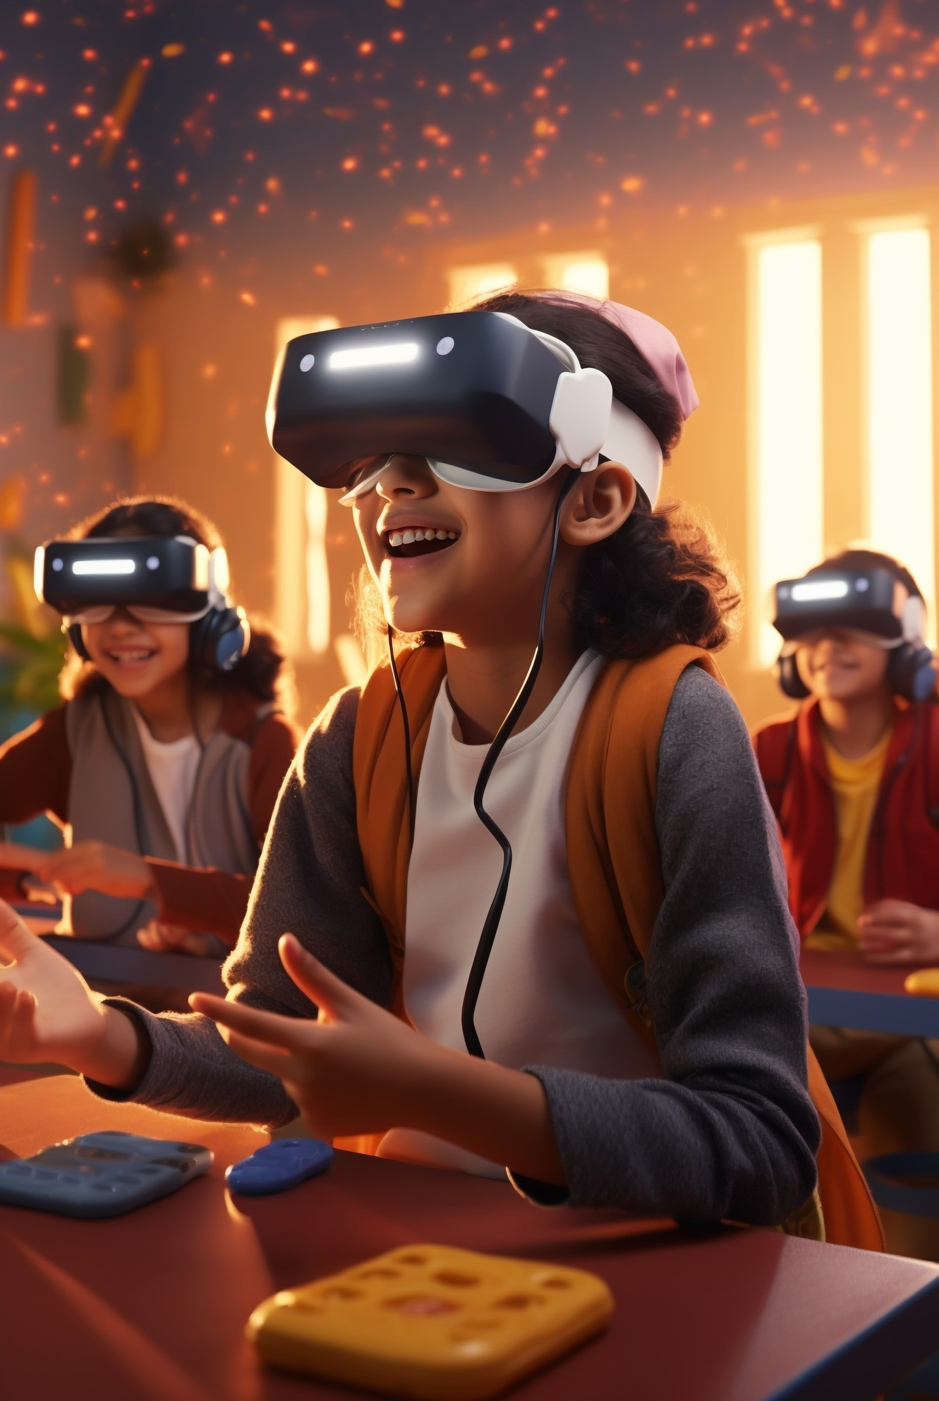
Target Audience
Individuals passionate about environmental conservation and sustainability efforts
Students, educators, and educational institutions seeking innovative tools for experiential learning and environmental education.
Gamers looking for meaningful gaming experiences that contribute to social causes and promote positive change.

Slide 5

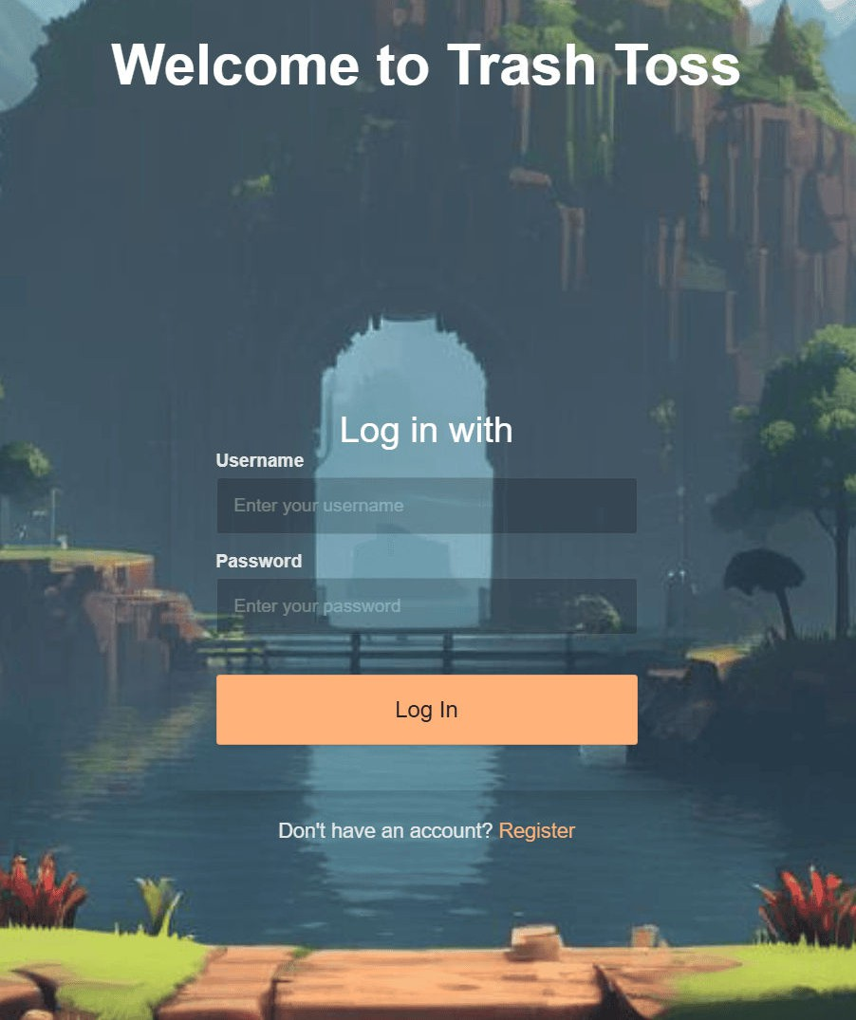
Website Discription
Our project website serves as the central hub for accessing and engaging with the gamiﬁed content designed to promote nature protection.
Website has been developed using Flask.
Functionalities:
Login Page:
Users can securely log in to their accounts using unique credentials.
Authentication mechanisms ensure data privacy and protection.
Registration Page:
New users can easily create accounts by providing necessary details. Registration process is
straightforward and user-friendly.

Slide 6

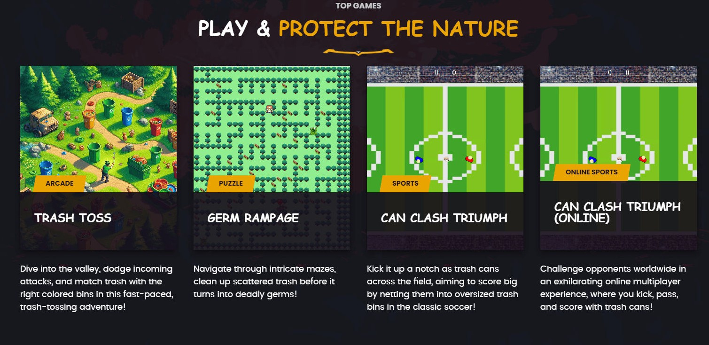

Website Discription
Homepage:
Game links and descriptions are prominently featured,
guiding users to explore and engage with the gamiﬁed content.
Game links and descriptions are prominently featured,
guiding users to explore and engage with the gamiﬁed content.
Proﬁle Page:
Each user has a personalized proﬁle page displaying their gaming statistics .
Users can track their progress, view high scores, and compare their performance with others.
Integration with Database:
The website seamlessly integrates with a robust
database system using SQL to store user information securely . User data, including login credentials,
Max Scores , Global Max Scores,
Global Top 5 Scores can be accessed.

Slide 7

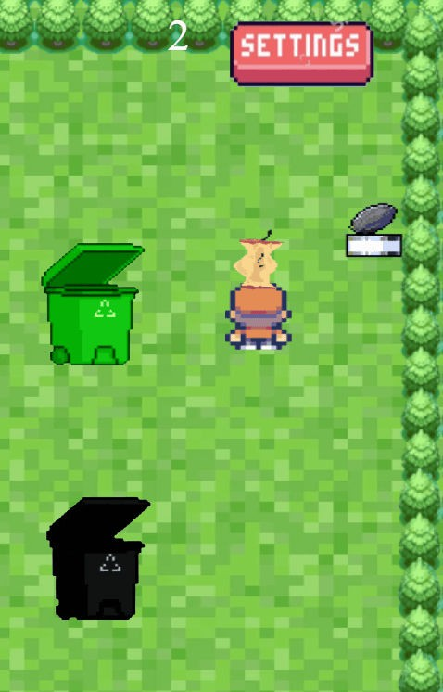
Trass Toss
Description:
Trass Toss is an exciting and educational game designed to simulate the challenges of waste
management in a fun and engaging manner. Set in a vibrant valley environment, players are tasked with the important mission of cleaning up litter and
disposing of it properly while facing various obstacles. Trass Toss is developed using JavaScript. JavaScript facilitates smooth and responsive gameplay, enabling
dynamic interactions, compatibility with web-based gaming platforms. and immersive experiences for players.
Game Mechanics and Objectives:
Players navigate through the valley landscape,
searching for scattered trash items. The primary objective is to pick up the trash and dispose of it in the corresponding colored dustbins. Players must avoid dustbin monsters that emerge randomly to attack, threatening to impede progress and reduce player health. Successful disposal of trash into the correct bins earns points and contributes to the overall cleanup e orts.

Slide 8
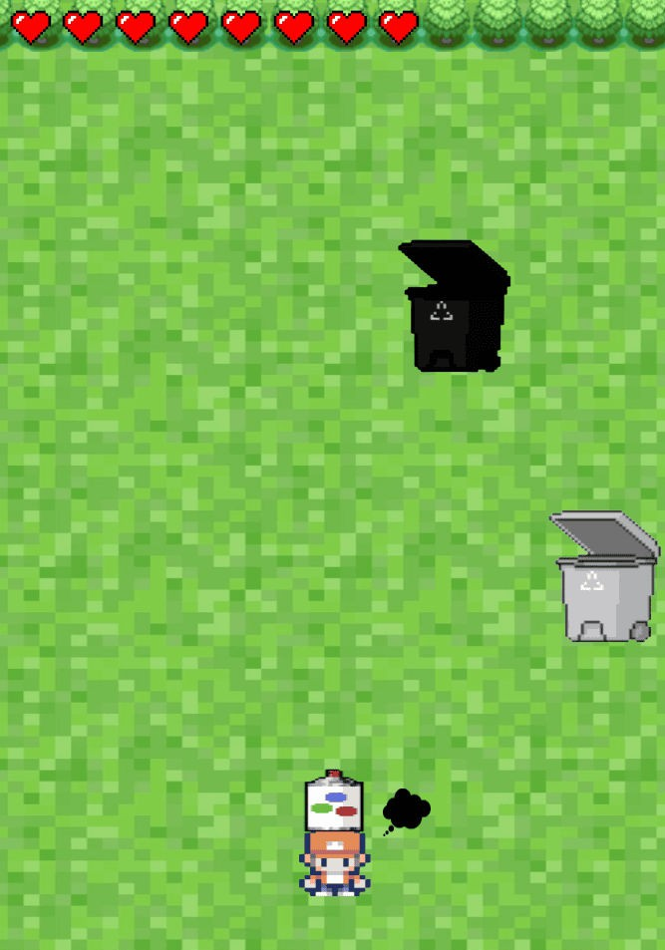
Trash Toss
Features:
Trash Pickup and Disposal: Players interact with the environment to collect trash items using intuitive controls. Trash items must be thrown into the appropriate colored dustbins for proper disposal.
Dustbin Monsters Attacking :Dustbin monsters periodically appear to challenge players, adding an element of excitement and urgency to the gameplay. Players must strategically evade or eliminate these monsters to continue their cleanup mission.
Health and Lives System: Players have a limited number of lives, representing their resilience in the face of obstacles. Collisions with dustbin monsters result in the loss of health points, potentially leading to game over if all lives are depleted.
Point Scoring System: Points are awarded for each successful trash disposal, with higher scores achieved for correct bin placements.
Accumulating points allows players to track their progress and
compete for high scores.

Slide 9
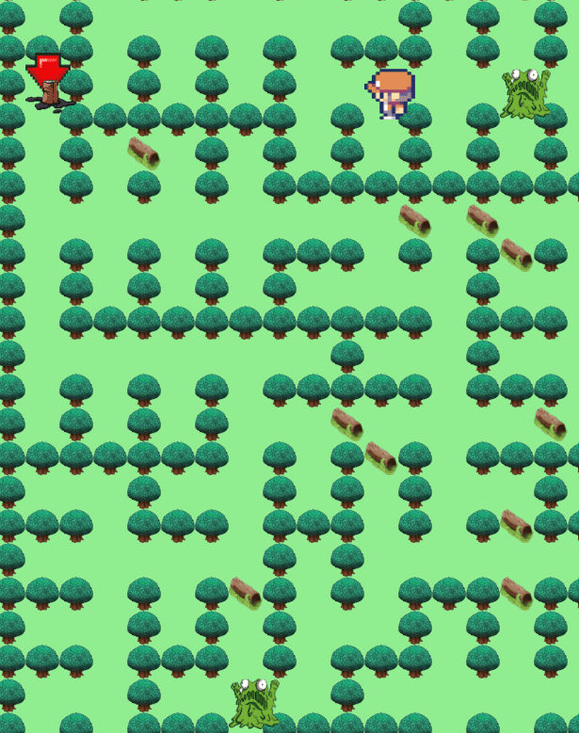
Germ Rampage
Description:
Germ Rampage is an immersive adventure game that challenges players to navigate through
intricate mazes while addressing the issue of waste management. Developed using JavaScript
.JavaScript enables seamless integration of
game mechanics, responsive controls, and interactive elements, enhancing the overall gaming experience.
Game Mechanics and Objectives:
Players navigate through maze-like forests, seeking out and collecting scattered trash items within a speciﬁed time limit. The primary objective is to clean up the maze by collecting all trash items before they transform into germs (monsters) and impede progress. Players must use strategic planning and quick reﬂexes to avoid collisions with germs and other obstacles while e ciently clearing the maze of litter.

Slide 10
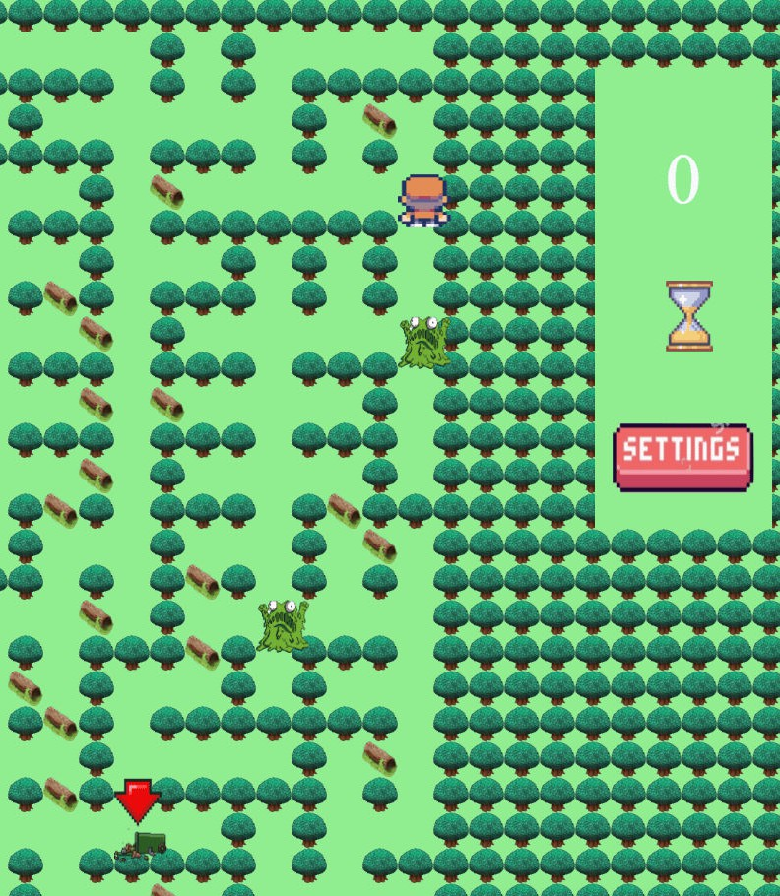
Germ Rampage
Features:
Maze Navigation: Players use directional controls to maneuver through the maze-like forest environment, exploring branching pathways and uncovering hidden areas. Navigating efficiently is crucial to maximize trash collection and complete the maze within the allotted time.
Time-based Trash Generation: Trash items appear randomly throughout the maze at timed intervals, adding a dynamic element to gameplay. Players must prioritize trash collection while managing the countdown timer to prevent the emergence of germs.
Germs (Monsters) as Obstacles: Germs serve as formidable obstacles that hinder player progress and pose a threat to successful completion of the maze.
Colliding with germs results in penalties such as slowed
movement or loss of health, increasing the challenge level.
Point Scoring System: Points are awarded for each trash item collected and properly disposed of within the designated trash bins. Efficient completion of the maze and avoidance of hazards contribute to higher scores and leaderboard standings.

Slide 11
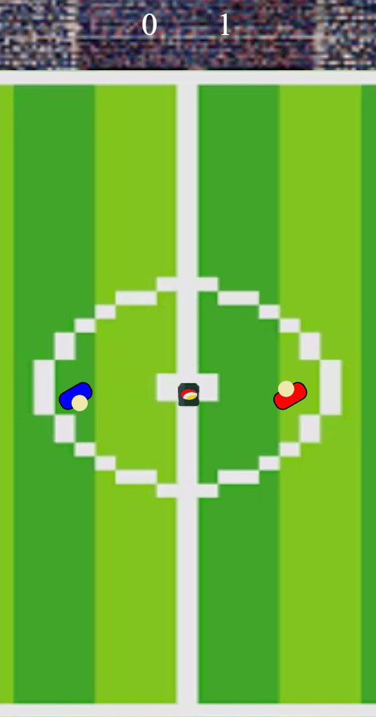
Can Clash Triumph
Description:
Trash Soccer o ers a unique twist on traditional soccer gameplay by incorporating elements of waste management and environmental
conservation. Players engage in fast-paced matches using trash cans as goal posts, competing both offline and online to score goals and emerge victorious. The Game has been developed using Javascrit as
the Programming Language and with node.js to enable online Mutiplayer mode.
Game Mechanics and Objectives:
Players control soccer players equipped with trash cans as goal-
scoring instruments, aiming to outmaneuver opponents and score goals.
The primary objective is to accumulate points by successfully kicking
trash into the opposing team's goal while defending against incoming shots.
Large-sized dustbins serve as goal posts, adding an unconventional and environmentally conscious twist to traditional soccer matches.

Slide 12
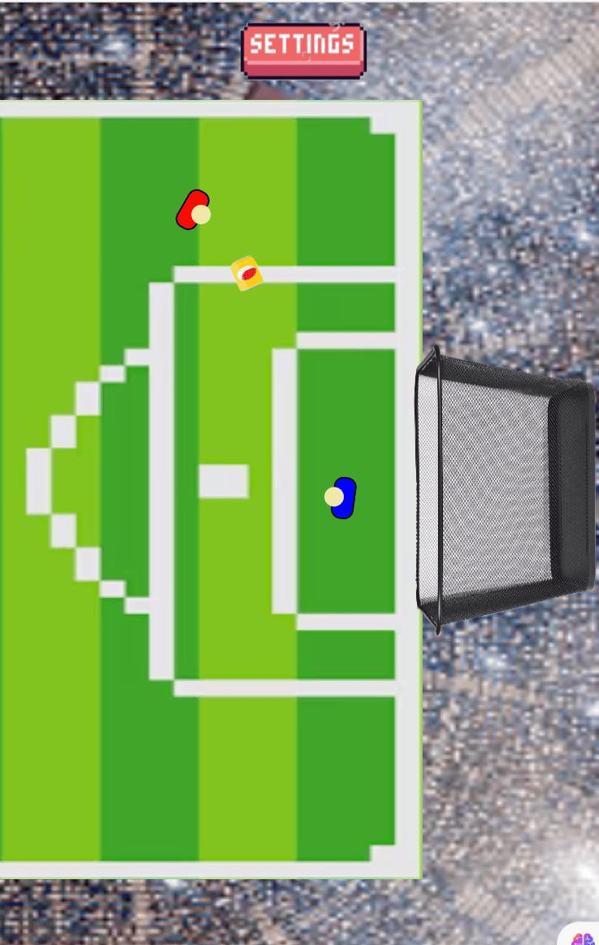
Can Clash Triumph
Features:
Offline and Online Modes: Trash Soccer o ers both o ine and online gameplay modes to accommodate solo and multiplayer experiences. O ine mode allows players to compete against the opponent using the same keyboard, while online mode enables real-time multiplayer matches against friends or other players worldwide.
Implementation using Node.js for Online Mode: Online multiplayer functionality is implemented using Node.js, Node.js facilitates seamless matchmaking, player connectivity, and synchronous gameplay experiences in online matches.
Matchmaking algorithms ensure balanced and
fair matchups, enhancing the competitiveness and excitement of online play.

Slide 13
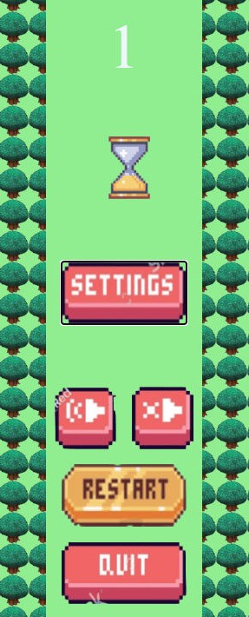
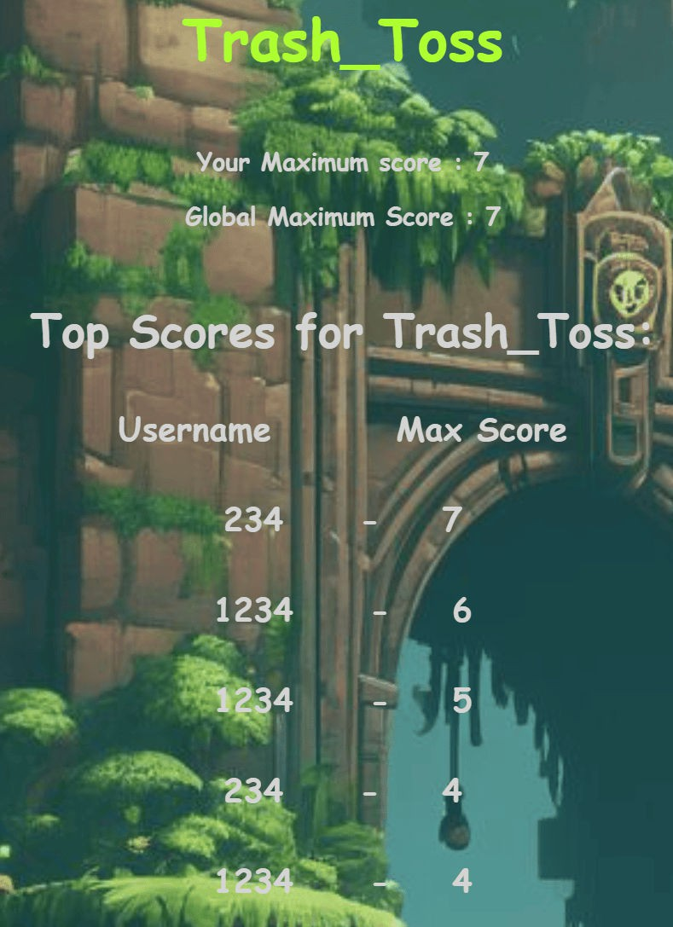
Common Features Across Games
Features:
Mute, Volume, Quit, Restart Buttons: Each game includes intuitive controls for adjusting audio settings, allowing players to toggle between mute and volume settings based on their preferences. Additionally, players have the option to quit the game or restart a level at any time, providing ﬂexibility and convenience during gameplay.
Integration with Website for User Data
Tracking: Integration with our project website enables seamless tracking of user data, including game progress, achievements, and high scores. Player statistics and performance metrics are securely stored and accessible through the website's proﬁle page, allowing users to monitor their progress and compete with others.

Slide 14

Metrics for Evaluating Our Game
Sophisticated Game Logic:
Our game features intricately designed mechanics that o er depth and complexity,
providing players with engaging experiences. The environmental interactions add dynamism to gameplay. Players are presented with a variety of creative scenarios and challenges, enhancing replayability and immersion.
Scoring Mechanisms: The scoring system e ectively rewards player performance and skill, encouraging strategic decision-making and mastery of game mechanics. We have carefully ensured that players can access the Global top scorers and also access their maximum score.
User Interface (UI) Design: The visual appeal of our game's UI elements enhances the overall gaming experience, capturing players' attention and interest. Our UI design prioritizes usability and intuitiveness, allowing players to easily navigate menus and access essential information during gameplay.
Latency and Responsiveness: Our game boasts excellent responsiveness to player inputs, providing smooth and ﬂuid gameplay that enhances immersion and enjoyment. Input lag is minimized, ensuring that players can accurately control their characters and interact with game elements without delay.

